Slide 1
Maryland NextGen Testbank: Maternal Newborn Mini-Review

Slide 2
NextGen Test Bank Disclosures
This review uses items in the Maryland NextGen Test Bank accessed with a Qualtrics link or QR Code.
The Maryland Testbank contains peer-reviewed items written by faculty across the State of Maryland that attempt to align with publicly available information about Next Generation NCLEX.
The Maryland NextGen Test Bank Project was funded by the Maryland Nursing Workforce Center as part of a grant from the Maryland Higher Education Commission Nurse Support Program II # 20-125.
This review will take approximately 1.5 to 2 hours to complete.
For best result, use a laptop, notebook, or desktop to answer the questions.

Slide 3
About The NextGen NCLEX
Starting April 1, 2023, graduates will take an updated version of the National Council Licensure Exam referred to as Next Generation NCLEX.
Next Generation NCLEX (NGN) will continue to test a candidate’s ability to provide safe client care while incorporating new methods to better test clinical judgment.
The testing methods will include using new item response types in clinical judgment case studies and stand-alone questions to test the NCSBN Clinical Judgment Measurement Model(NCJMM) (https://www.ncsbn.org/exams/next-generation-nclex/NGN+Resources/clinical-judgment-measurement-model.page)

Slide 4
The Five New Item Response Types
Extended multiple response items with increased answer options.
Drag-and-drop items that involve moving options to placeholders.
Drop-down items where candidates select the missing words from sentences, paragraphs, or tables.
Highlight items that require candidates to identify parts of the medical record to answer questions.
Matrix/grid items that involve completing tables of information.

Slide 5
Case Studies
Unfolding case studies use approved NGN item types to answer questions about evolving real-world nursing scenarios.
Case studies present 6 linked questions to test the 6 steps of the NCJMM in order:
Recognize cues
Analyze cues
Prioritize hypotheses
Generate solutions
Take action
Evaluate outcomes
Candidates should expect to complete 3 to 5 case studies in a minimum length 85 question NCLEX exam.

Slide 6
Stand-alone Item Types
Stand-alone (single) items test either client needs or clinical judgment
Client needs items test knowledge of the 8 client needs using traditional or new item types.
Clinical judgment items present information in a clinical scenario specifically targeting one or more NCJMM clinical judgment step.
There are 2 unique types of clinical judgment stand-alone items:
Bowtie
Trend
Clinical judgment stand-alone items make up approximately 10% of stand-alone items.

Slide 7
Stand-alone Item: Bowtie
A bowtie is a drag-and-drop response item variation.
After reading a clinical scenario, candidates move response options (tokens) to placeholders (targets).
On NCLEX the placeholders are arranged in the shape of a bowtie.
Candidates must select:
1 condition the client is most likely experiencing from 4 options.
2 actions to take to address the condition from 5 options.
2 parameters to monitor the client’s progress from 5 options.

Slide 8
Stand-alone Item: Trends
Trend items require the candidate to make clinical judgments based on client data presented at different time points.
Trend items may address one or more clinical judgment steps but do not follow the six-item sequence like case studies do.
Trend items can feature any item response type except bowtie.

Slide 9
About This Review
Your instructor will provide a QR code or link to answer a series of case studies, bowtie items and trends across a lifespan
While questions throughout the test bank use all 5 new item response, not all specific variations that might be used on NCLEX are not included such as drop-down items formatted as a table.
Information needed to answer questions will be displayed in a medical record, but the medical record will display differently on the actual NCLEX.
To see how items will exactly appear on NCLEX see tutorials at https://nclex.com/next-generation-nclex.page

Slide 10
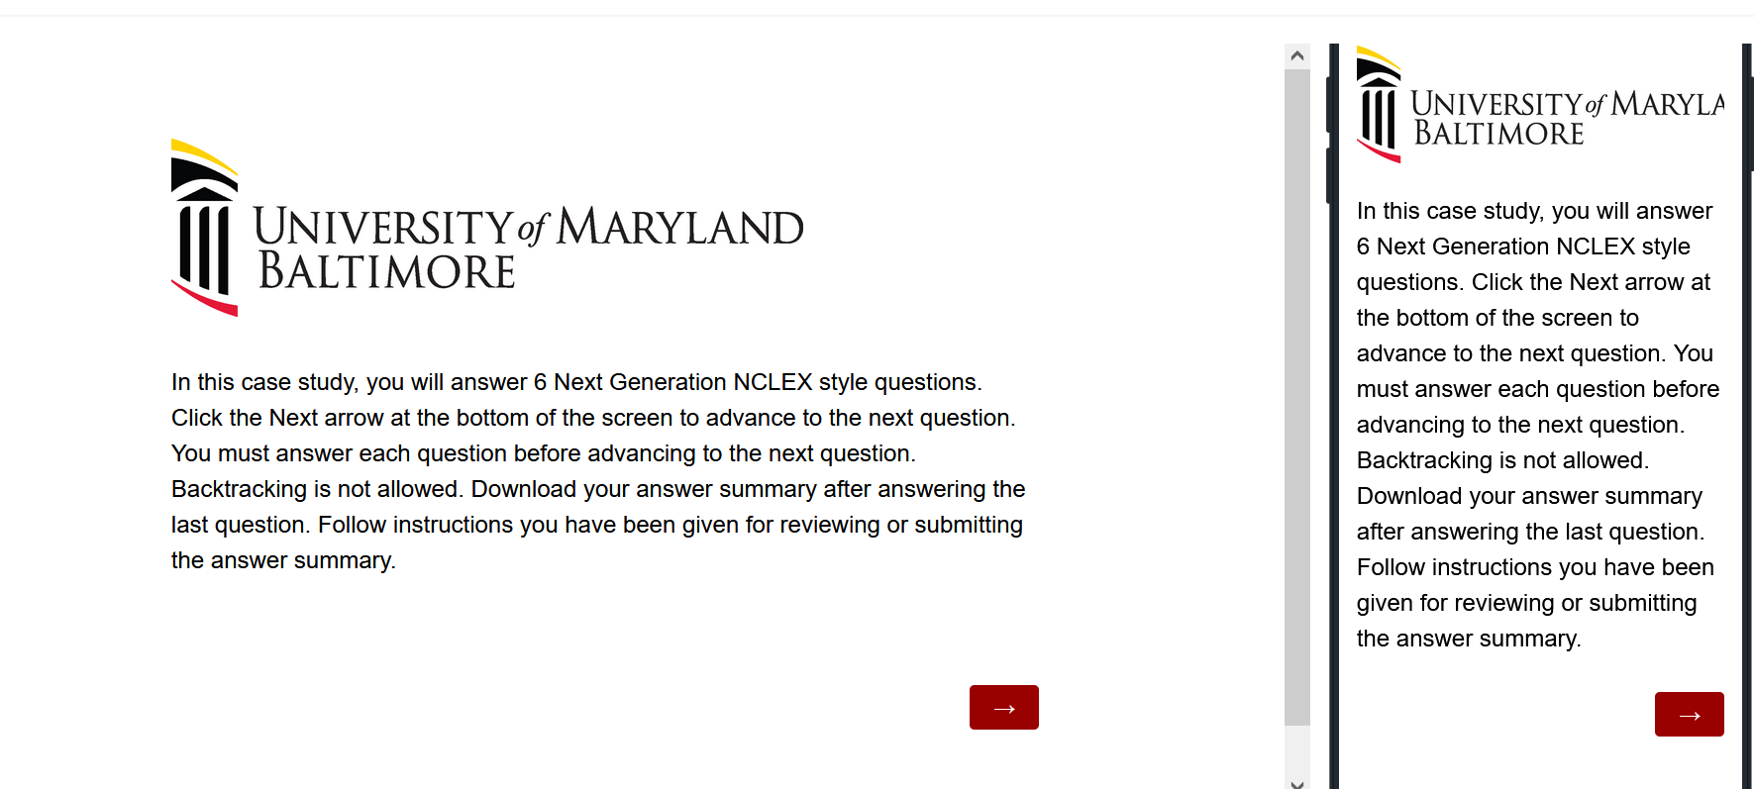
The First Screen Provides Instructions
Use the arrow to advance the screens
There is no backtracking

Slide 11
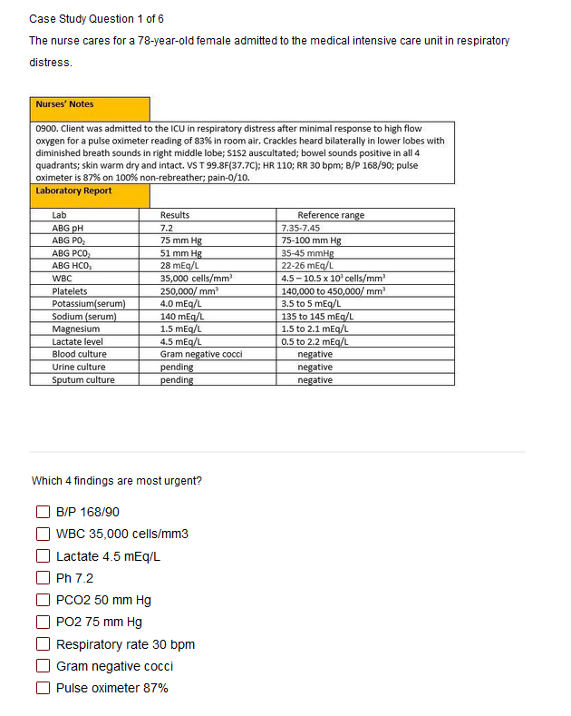

Answer the Questions
Read the instructions carefully.
Sometimes the question tells how many options to pick.
Other times you select all that apply.
Some questions will not allow you to advance if they have not answered enough options.
Use the arrow to advance to the next question if doing a case study

Slide 12
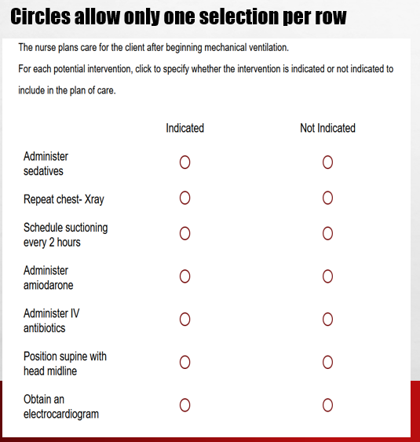
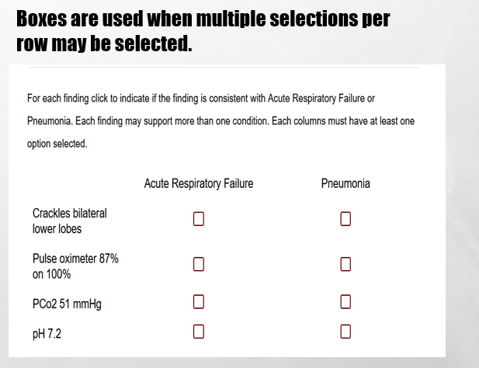
In Tables, Follow Instructions for How Many Options May be Selected in a Row.

Slide 13
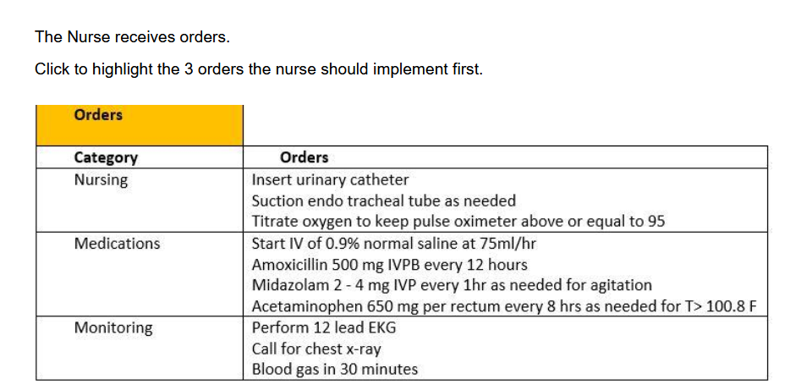
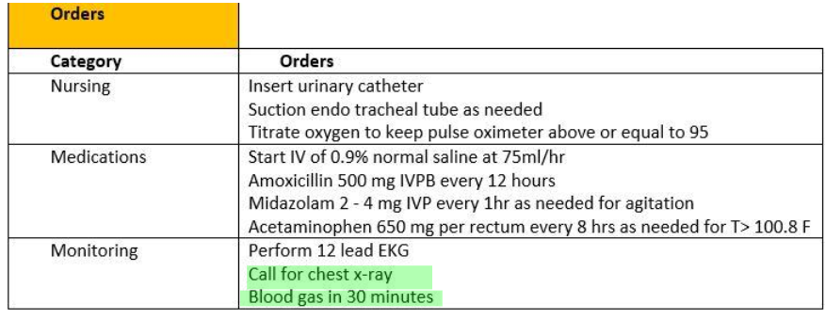
Highlight Questions
Questions first show a plain EMR page
Hovering curser makes boxes appear around selectable data
Click the box to apply the highlight; A second click removes it.

Slide 14
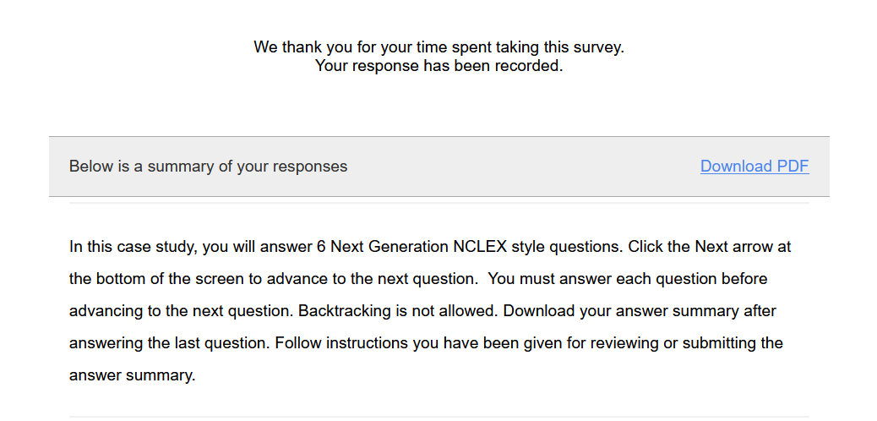
Submit the Final Question and Click Download PDF from Thank You Screen
It is the only way to save your answers.
This step is critical!

Slide 15
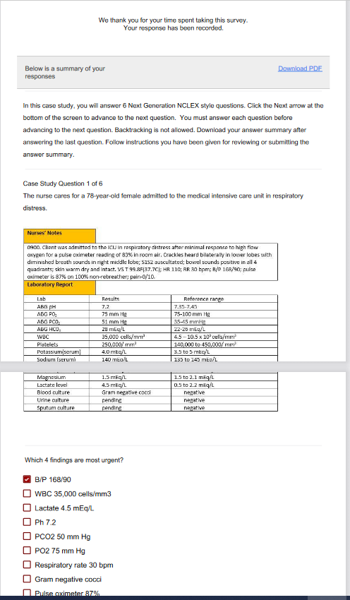
The Response Summary Shows Your Answers
Follow your faculty’s instructions for saving the response summary.
They may have you print it out, save it to computer, or upload it to a learning management system.
The response summary DOES NOT give you the correct answers.
Answers will appear on subsequent slides with information on how to score the item and a rationale for the answer.

Slide 16
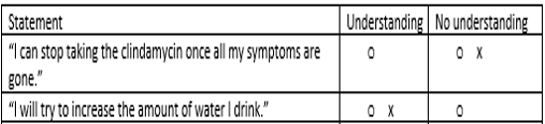
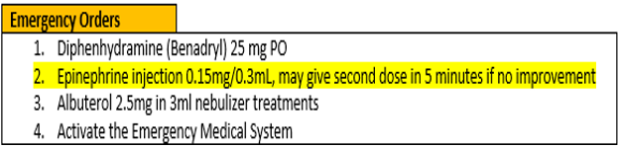
Correct Answers
Correct answers may be indicated 1 of 4 ways
Asterisk appears after correct option*
Option may be underlined with or without an *
Option may appear as an X or * in a table
Correct answer may appear as highlight

Slide 17
New Scoring Rule: +/-
Used when takers may pick unlimited options
Possible points are number of keyed correct items
Earn 1 point for each correct item selected
Loose 1 point for each incorrect item selected
Guessing penalty prevents takers from gaming system by selecting all
Minimum score =0
Which items are viruses? Select all that apply.
■ Chlamydia
■ Influenza[✓]
■ Hepatitis B [✓]
Lyme disease
Pertussis
Tuberculosis
Varicella [✓]
+/- Scoring rule
3 points possible
+2 correct
-1 incorrect
-----------------
1 points

Slide 18
New Scoring Rule: 0/1
Used when takers may select limited options
Possible points are number of keyed correct items
Earn 1 point for each correct item selected
Earn 0 points for incorrect responses
Minimum score 0
Which 3 items are viruses?
■ Chlamydia
■ Influenza[✓]
■ Hepatitis B [✓]
Lyme disease
Pertussis
Tuberculosis
Varicella [✓]
0/1 Scoring rule
3 points possible
+2 correct
-----------------
2 points

Slide 19
Same Answers: Different Scores
Select all that apply
Which 3 items are viruses?
■ Chlamydia
■ Influenza[✓]
■ Hepatitis B [✓]
Lyme disease
Pertussis
Tuberculosis
Varicella [✓]
Which items are viruses? Select all that apply
■ Chlamydia
■ Influenza[✓]
■ Hepatitis B [✓]
Lyme disease
Pertussis
Tuberculosis
Varicella [✓]
0/1 Scoring rule
3 points possible
+2 correct
-----------------
2 points
+/- Scoring rule
3 points possible
+2 correct
-1 incorrect
-----------------
1 point

Slide 20
Rationale Scoring Rule
Complete the sentence from list of dropdown options.
To prevent night blindness the nurse would recommend
because they are rich in vitamin
Used when question has linked concept and a justification in the same sentence
Example: The client most likely has an asthma exacerbation as evidenced by the breath sounds.
Dyad worth 1 point
One cause and one effect
Both parts must be correct for credit
Triad worth 2 points
One cause 2 effects
Cause must be right for any credit
Partial credit given (1 point) if only 1 effect is correct
almonds
carrots✓
orange juice
A
B
C✗
Right condition,
Wrong justification =0 points

Slide 21
Keep track of your score as you move through the review
Item | My score
Trend 1
Case study 1
Bowtie 1
Case study 2
Trend 2
Case study 3
Total

Slide 22
Final Link
The final link in the review takes you to the course evaluation.
This anonymous information will be used to help us understand how this review is being used and how to improve the experience.

Slide 23
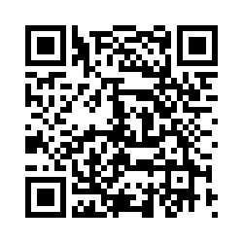
Trend # 1
URL
QR Code
https://umaryland.az1.qualtrics.com/jfe/form/SV_02IHwhHpiblxzb8
Take 2-3 minutes

Slide 24
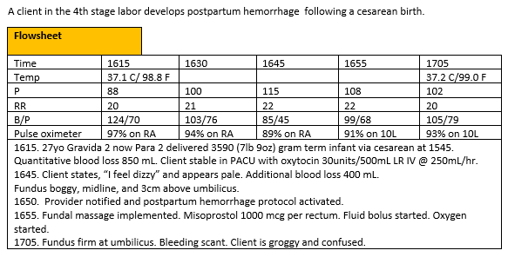
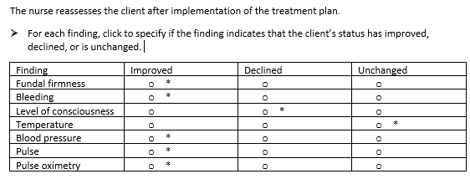
0/1. This item is worth 7 points. Give yourself 1 point for every row you got correct .

Slide 25
Rationale
The trends in the vital signs, firm fundus, and cessation of bleeding indicate the client is improving. The level of consciousness has declined from dizzy to groggy due to the blood loss. The correct action is to continue to monitor the patient.

Slide 26
Trend 1 Score
 | Possible | My score
Points | 7
Total | 7

Slide 27
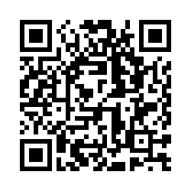
Case Study # 1
URL
QR Code
https://umaryland.az1.qualtrics.com/jfe/form/SV_eyabT2E95Uker4O
Take about 10 minutes

Slide 28
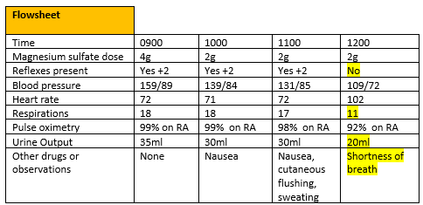
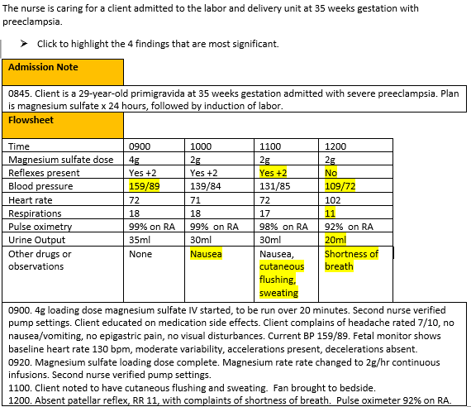
Screen 1 of 6
+/-. This question is worth 4 points.
Give yourself 1 point for each correct response AND subtract 1 point for every incorrect answer you picked. The worst you can score is 0.

Slide 29
Rationale
Magnesium toxicity is characterized by respiratory depression, decreased urinary output, and loss of deep tendon reflexes. Cutaneous flushing and sweating are expected side effects of magnesium administration and are not concerning. Blood pressure at 0900 is expected since the client has severe preeclampsia. Magnesium infusion can cause hypotension.

Slide 30
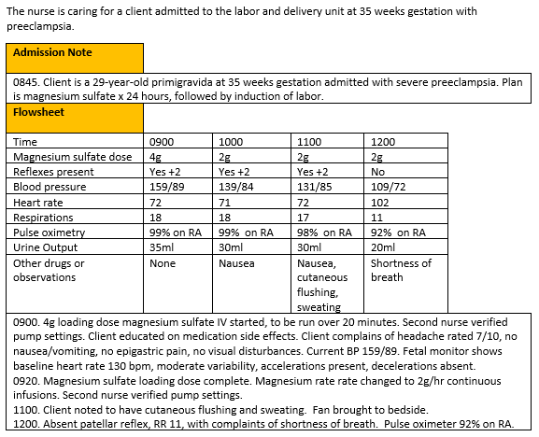
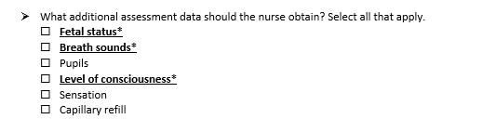
Screen 2 of 6
+/-. This question is worth 3 points.
Give yourself 1 point for each correct response AND subtract 1 point for every incorrect answer you picked. The worst you can score is 0.

Slide 31
Rationale
Any time the client is experiencing a complication the fetus should be assessed. Patients with preeclampsia and magnesium toxicity can experience pulmonary edema and changes in LOC, which would provide the nurse with additional assessment data.

Slide 32
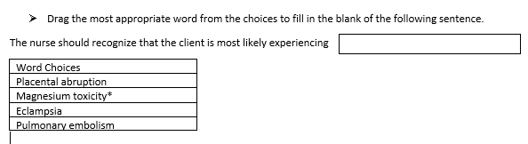
Screen 3 of 6
0/1. This question is worth 1 point.
Give yourself 1 point if you answered correctly.

Slide 33
Rationale
Trends are consistent with magnesium toxicity. Abruption would be accompanied by abdominal pain, uterine tenderness, potentially vaginal bleeding, and fetal distress. Seizures are required for eclampsia. Pulmonary embolism would be accompanied by chest pain.

Slide 34
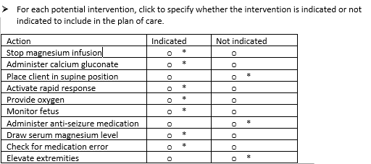
Screen 4 of 6
0/1. This question is worth 10 points. Give yourself 1 point for each row you got correct.

Slide 35
Rationale
When magnesium toxicity is suspected the infusion should be stopped, a rapid response activated, and calcium gluconate administered. The patient should receive oxygen because of respiratory depression. The fetus should be assessed any time there is a complication with the mother. Serum magnesium would confirm toxicity. Checking for medication error is necessary after medication-related complications. Supine position could make shortness of breath worse. Anti-seizure medication would be necessary for eclampsia, which this client does not have. Elevation of extremities is unrelated to magnesium toxicity.

Slide 36
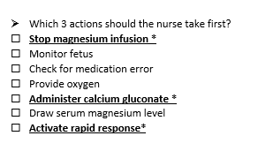
Screen 5 of 6
The
0/1. This item is worth 3 points. Give yourself 1 point for every correct option selected.

Slide 37
Rationale
Priority actions are to get help, stop the infusion, and administer the antidote calcium gluconate. The other interventions are warranted but not the immediate priority.

Slide 38
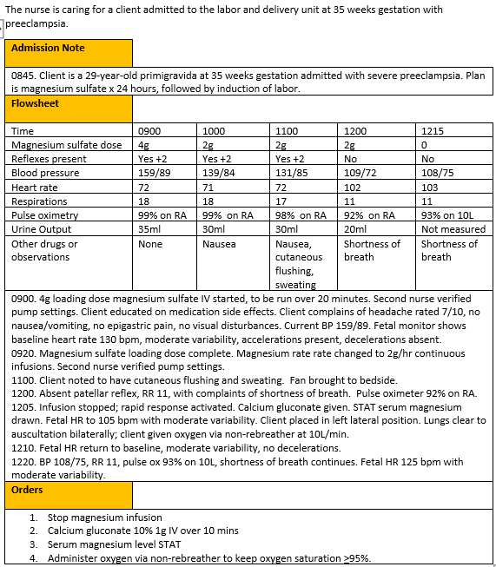
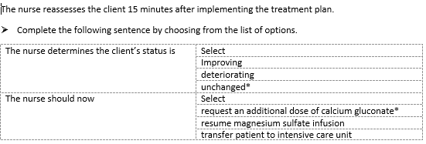
Screen 6 of 6
The
0/1. This item is worth 2 points. Give yourself 1 point for each correct response.

Slide 39
Rationale
Calcium gluconate is the antidote for magnesium toxicity and can be administered more than once if there is no improvement in client condition. Client has not improved, and magnesium sulfate infusion would be contraindicated. ICU is not warranted at this time.

Slide 40
Case Study 1 Score
Question | Possible | My score
1 | 4
2 | 3
3 | 1
4 | 10
5 | 3
6 | 2
Total | 23

Slide 41
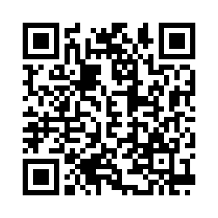
Bowtie # 1
URL
QR Code
https://umaryland.az1.qualtrics.com/jfe/form/SV_af3vDHcvZ7SSxtc
Take 2-3 minutes

Slide 42
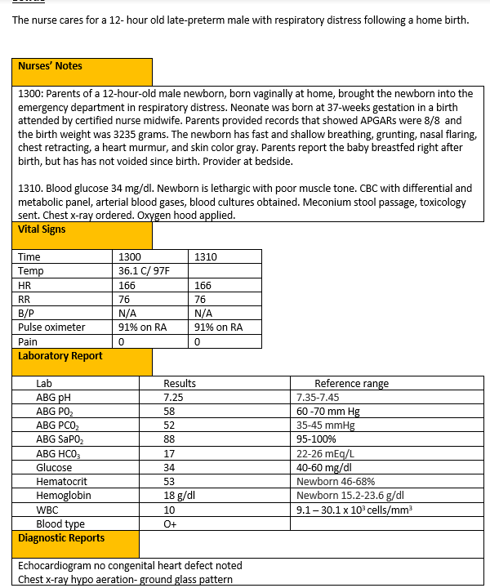
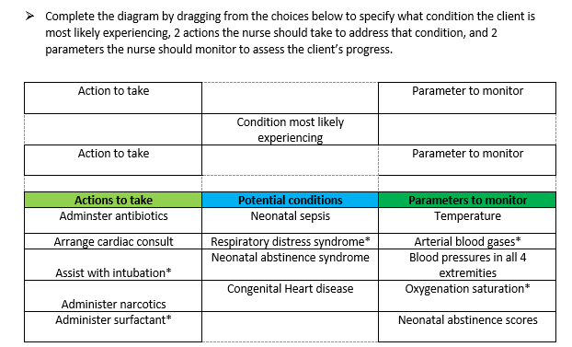
0/1. This item is worth 5 points. Give yourself 1 point for every correct selection.

Slide 43
Rationale
The newborn has respiratory distress syndrome. The priority action is to assist with intubation and administer surfactant. The assessments to monitoring for evidence of effectiveness of care are oxygenation saturation and ABGs.

Slide 44
Bowtie 1 Score
Question | Possible | My score
Conditions | 1
Actions | 2
Parameters | 2
Total | 5

Slide 45
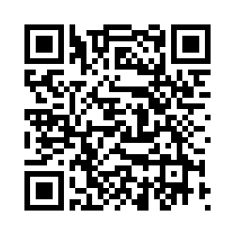
Case Study # 2
URL
QR Code
https://umaryland.az1.qualtrics.com/jfe/form/SV_1OnVNFDIaCXiEjc
Take about 10 minutes

Slide 46
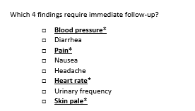
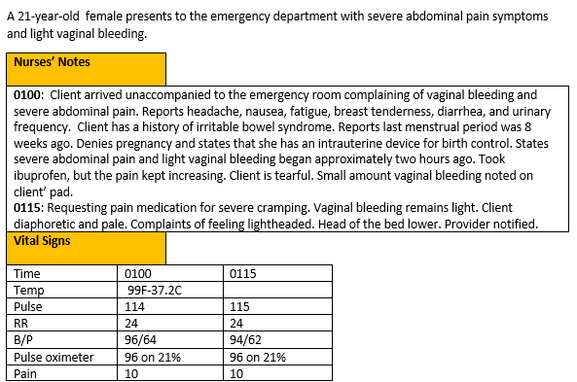
Screen 1 of 6
0/1. This question is worth 4 points.
Give yourself 1 point for each correct response.

Slide 47
Rationale
The client’s vital signs are trending towards hypovolemic shock. The nurse should recognize the new symptoms of paler and diaphoretic.

Slide 48
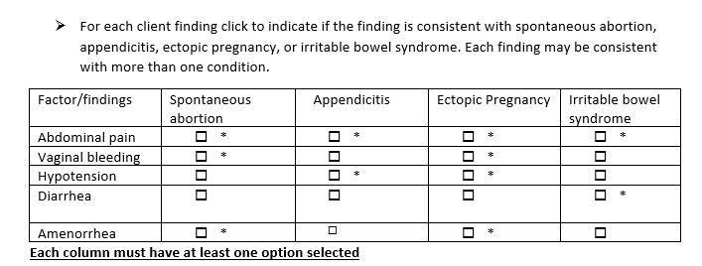
Screen 2 of 6
+/-. This question is worth 11 points. Score each column separately first then add scores together. Earn 1 point each correct item selected AND subtract 1 point for each incorrect option you select. The worst you can score is 0 per column
Column 1- 3 points
Column 2 -2 points
Column 3 -4 points
Column 4 -2 points

Slide 49
Rationale
Amenorrhea, abdominal pain and vaginal bleeding are the classical clinical triad of symptoms for an ectopic pregnancy. Spontaneous abortion cramping, bleeding, should not produce hypotension unless there is excessive bleeding. Appendicitis would not produce vaginal bleeding. Irritable bowel syndrome has abdominal pain, but no vaginal bleeding.

Slide 50
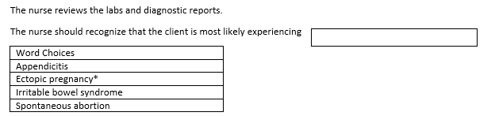
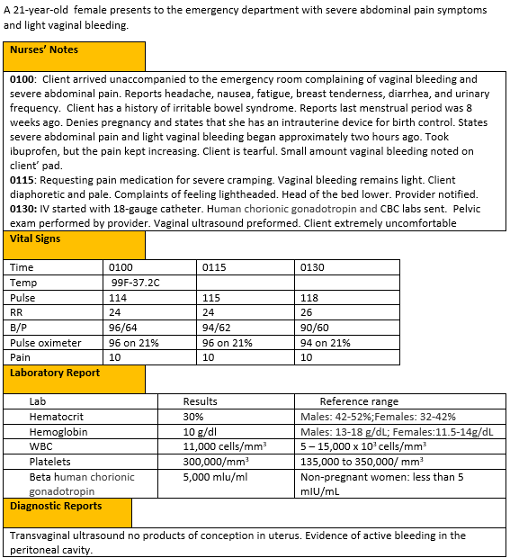
Screen 3 of 6
0/1. This question is worth 1 point.
Give yourself 1 point if you answered correctly.

Slide 51
Rationale
The beta human chorionic gonadotropin levels indicate the client is pregnant. Amenorrhea, abdominal pain and vaginal bleeding are the classical clinical triad of symptoms for an ectopic pregnancy. Spontaneous abortion cramping, bleeding, should not produce hypotension unless there is excessive bleeding. Appendicitis would not produce vaginal bleeding. Irritable bowel syndrome has abdominal pain, but no vaginal bleeding.

Slide 52
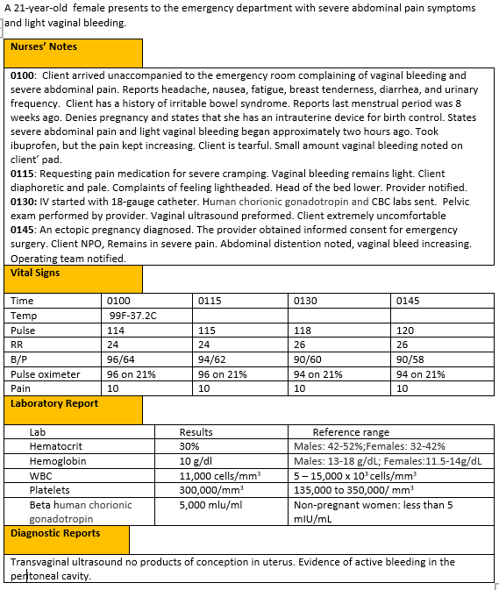
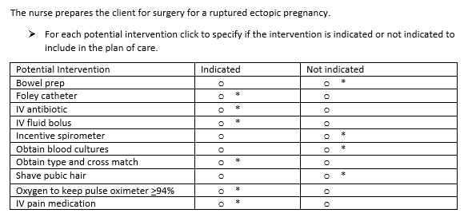
Screen 4 of 6
0/1. This question is worth 10 points. Give yourself 1 point for each row you got correct.

Slide 53
Rationale
The nurse should address the client’s pain needs once the diagnosis made. Prepping the client for surgery could include an IV fluids bolus, foley catheter, and prophylactic antibiotic. The nurse should provide oxygen if the client’s pulse oximeter readings decrease. No, bowel prep is indicated and it may delay time to the surgical suite. Blood cultures are not appropriate there is no evidence of infection. Pubic hair removal is not the standard of care. Shaving can increase infection risk. Incentive spirometer is post- operative management.

Slide 54
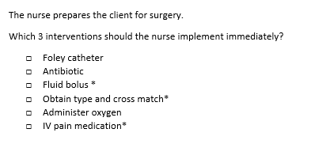
Screen 5 of 6
The
0/1. This item is worth 3 points. Give yourself 1 point for every correct option selected.

Slide 55
Rationale
The client needs emergency surgery. Her immediate needs are to maintain perfusion. The client requires a fluid bolus and a type and cross match for blood. She also requires management of her severe pain. Oxygen orders are implemented if saturations drop. Antibiotics can be started at any time before surgery. A foley catheter can be inserted when the client is more comfortable and able to cooperate, or it can be inserted in the surgical suite.

Slide 56
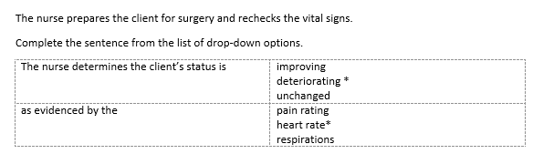
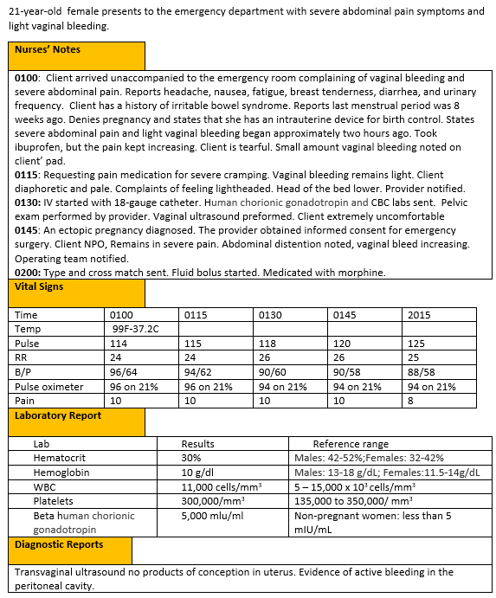
Screen 6 of 6
The
Rationale. This item is worth 1 points. Give yourself 1 point only if you got BOTH answers correct.

Slide 57
Rationale
Client’s vital signs are trending towards hypovolemic shock as evidenced by the heart rate is trending upward, and the decreasing B/P and oxygenation saturation.

Slide 58
Case Study 2 Score
Question | Possible | My score
1 | 4
2 | 11
3 | 1
4 | 10
5 | 3
6 | 1
Total | 30

Slide 59
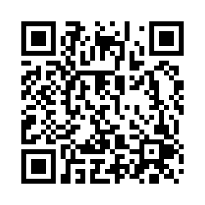
Trend # 2
URL
QR Code
https://umaryland.az1.qualtrics.com/jfe/form/SV_cYAq5EdHgMIXe6i
Take 2-3 minutes

Slide 60
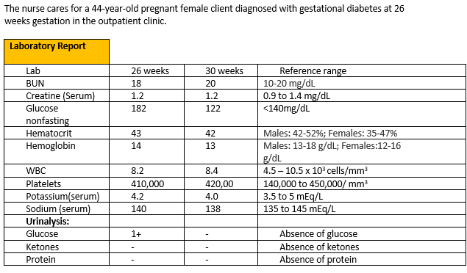
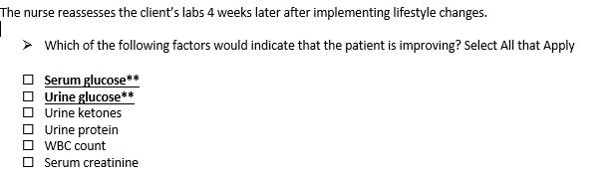
+/-. This item is worth 2 points. Give yourself 1 point for correct option selected . Subtract 1 point for each incorrect option selected. The worst you can score is 0.

Slide 61
Rationale
The client had elevated serum glucose presence of glucose in urine at 26 weeks gestation. All other factors were normal. The serum glucose is now acceptable and there is no glucose in the urine.

Slide 62
Trend 2 Score
Question | Possible | My score
Points | 2

Slide 63
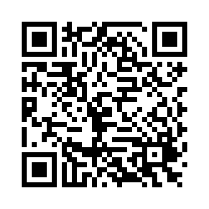
Case Study # 3
URL
QR Code
https://umaryland.az1.qualtrics.com/jfe/form/SV_4N2ZNXQa8zerYHA
Take about 10 minutes

Slide 64
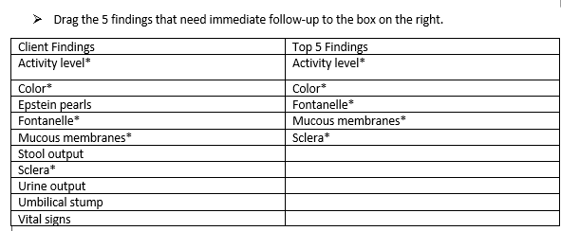
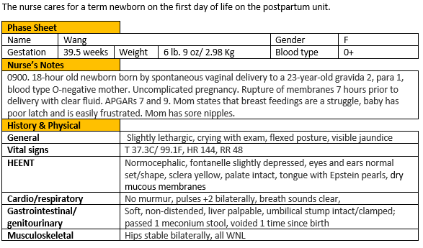
Screen 1 of 6
0/1. This question is worth 5 points.
Give yourself 1 point for each correct response.

Slide 65
Rationale
Bilirubin is produced by the breakdown of hemoglobin. A build-up of bilirubin in the body causes a yellow skin color called jaundice. Jaundice and yellow sclera are signs of hyperbilirubinemia. This is urgent as high bilirubin can cause brain damage and death. This combined with the dry mucous membranes, and slightly depressed fontanelle may indicate the newborn is developing hypovolemia. Both hypovolemia and hyperbilirubinemia can cause lethargy. Epstein pearls are very small keratin cysts that appear in the mouths of more than 50% of newborns. Epstein pearls are benign and disappear after a few weeks. A clamped umbilicus is normal. Passing 1 stool and voiding once on day 1 are typical findings/ The vital signs are within normal limits for a newborn.

Slide 66
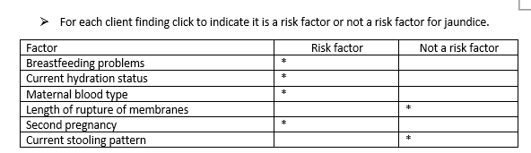
Screen 2 of 6
0/1. This question is worth 6 points
Give yourself 1 point for each row you get correct.

Slide 67
Rationale
Hyperbilirubinemia can come from increased bilirubin production and or delayed excretion. The majority of bilirubin is produced from the breakdown of hemoglobin into unconjugated bilirubin. Unconjugated bilirubin binds to albumin in the blood for transport to the liver, where it is taken up by hepatocytes and conjugated to make it water-soluble so it can be excreted in stool and urine. Breastfeeding problems that lead to inadequate intake, and poor hydration, evidenced by the dry mucous membranes and depressed fontanelles, can result in decreased excretion of bilirubin. Rh incompatibility occurs when a mother who is type Rh - gives birth to an infant who is Rh+ and develops anti-Rh antibodies in her serum. The antibodies attack the infant’s blood cells, causing the cells to lyse and producing a hemolytic anemia. The development of antibodies typically happens during the birthing process, so antibodies are present in subsequent pregnancies. Passing 1 stool in the first day of life is an expected finding and would not be considered a risk factor. The length of rupture of membranes was typical and would not be considered a risk factor.

Slide 68
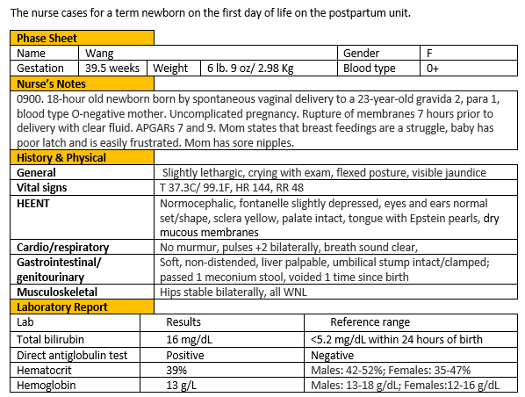
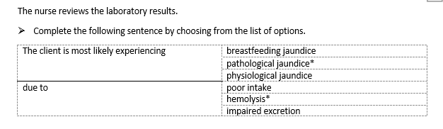
Screen 3 of 6
Rationale. This question is worth 1 point.
Give yourself 1 point only if you answered BOTH parts correctly.

Slide 69
Rationale
Visible jaundice on the first day of life and the high bilirubin level rising more than 5mg/dL a day indicate pathological jaundice. The direct antiglobulin test shows that there are maternal Rh antibodies adhering to the infant’s Rh+ red blood cells lysing the cells. Untreated, this will lead to a hemolytic anemia and possible kernicterus. Poor intake an excretion can complicate the problem but are not the underlying cause of the pathological jaundice.

Slide 70
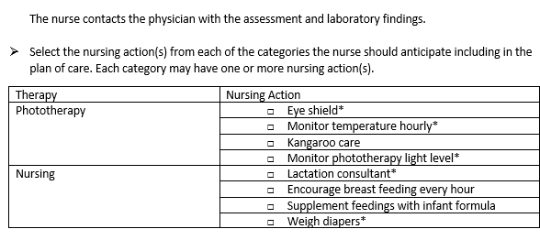
Screen 4 of 6
+/-. This item is worth 5 points. Score each category separately, then add scores together. Score 1 point for each correct response AND subtract 1 point for each incorrect answer. The worst you can score is 0 per category.
Phototherapy= 3 points
Nursing= 2 points

Slide 71
Rationale
Phototherapy lights can cause retinal damage, hyperthermia, and bronzed baby syndrome. The nurse must plan interventions to decrease the risk of these adverse effects of therapy. Dehydration is another potential complication of phototherapy. Phototherapy increases insensible water losses. To maximize time under the lights, it is recommended that the baby not be removed from under the phototherapy lights for more than 20 minutes every 3-4 hours. This can interfere with feeding. A lactation consultant can help the breastfeeding parent maximize the efficiency of the time breastfeeding. The nurse should monitor the neonate’s hydration status by weighing the diapers. Although this neonate is struggling to breastfeed, supplementing feedings with formula are not the first choice as they may interfere with establishing breastfeeding.

Slide 72
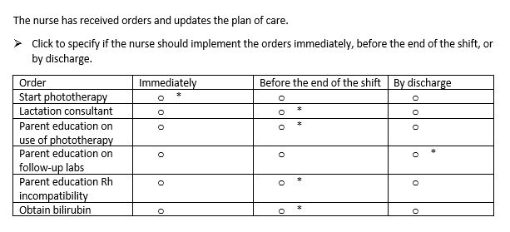
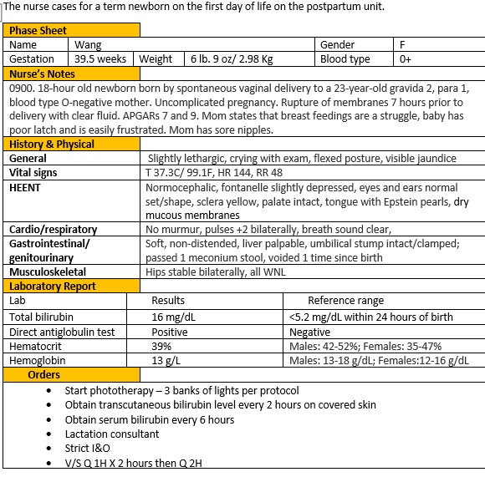
Screen 5 of 6
The
0/1. This item is worth 6 points. Give yourself 1 point for every row you got correct.

Slide 73
Rationale
Immediately – Based on the total serum bilirubin level phototherapy should be initiated.
Before end of shift –A lactation consultation is needed to improve breast feeding to help prevent dehydration and increase stooling to help excrete bilirubin. Parents will need to know how to interact with their infant while they are receiving phototherapy. Parents will need to understand the disease process as a rationale for the therapy needed and adherence to recommendations for time spent under phototherapy.
By discharge – Once the baby is discharged, follow-up total serum bilirubin levels may be needed to assess for rebound hyperbilirubinemia.

Slide 74
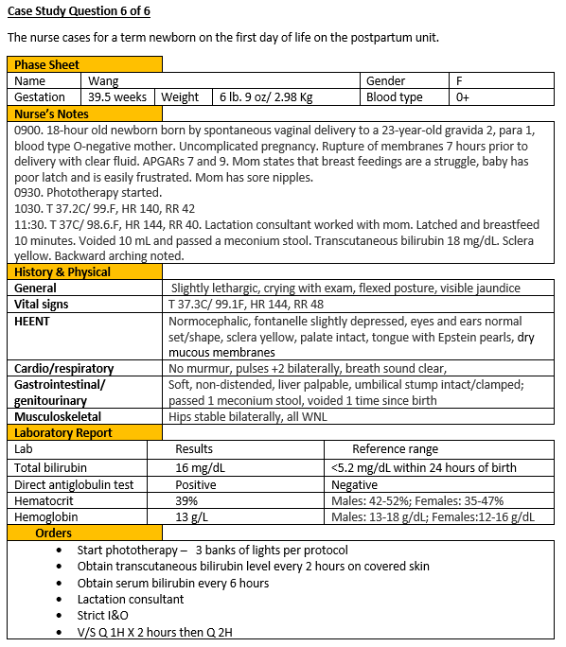

Screen 6 of 6
The
0/1. This item is worth 4 points. Give yourself 1 point for row you got correct.

Slide 75
Rationale
Breastfeeding has improved because the baby is able to latch now and has voided and stooled. The increased bilirubin levels after phototherapy shows a decline. The development of backward arching may indicate opisthotonos which develops as increased levels of unconjugated bilirubin cross the blood brain barrier and the bilirubin adheres to the neural cells in the brain. Opisthotonos is a sign of severe neurological damage. The sclera was yellow prior to beginning phototherapy and remains unchanged.

Slide 76
Case Study 3 Score
Question | Possible | My score
1 | 5
2 | 6
3 | 1
4 | 5
5 | 6
6 | 4
Total | 27

Slide 77
My Total
Items | Points Possible | My score
Trend 1 | 7
Case study 1 | 23
Bowtie 1 | 5
Case study 2 | 30
Trend 2 | 2
Case study 3 | 27
Total | 94

Slide 78

Please Complete the Mini Review Evaluation
https://umaryland.az1.qualtrics.com/jfe/form/SV_1ZYu3gxvlMDziMS
This evaluation will take approximately less than 2 minutes to complete.

